Slide 1
Critical Thinking, Creativity and Innovation

Slide 2
Case Study
CMS is a training initiative that provides team leaders the necessary skills and tools to lead and manage change, so they can successfully implement innovation projects in their field of work. There is also a need of creating a mutual trust between the leader and employees to maximize their potential which will ultimately result in increased productivity.
Questions:

Slide 3
Critical Thinking and Problem Solving
Critical thinking is the process to rationally analyze and attempt to solve a problem – accurately and efficiently without any assumption.
It is a cognitive skill or a mental process. Based on acquired knowledge, you’ll have to analyze, examine, and scrutinize options to create an opinion or set of actions.
"Critical thinking is the intellectually disciplined process of actively and skillfully conceptualizing, applying, analyzing, synthesizing, and/or evaluating information gathered from, or generated by, observation, experience, reflection, reasoning, or communication, as a guide to belief and action" (Scriven, 1996).

Slide 4
Why is Critical Thinking important?
By analyzing your thoughts, you can improve how efficiently you think, how intuitively you organize your thoughts and how often you recognize your biases.
When you think critically, you can study arguments, analyze what evidence supports them and make a reasoned decision about whether the arguments are correct.
Adopting critical thinking as a long-term practice can help you consider the perspectives of peers more often, become more honest about your mistakes and commit to the process o f lifelong learning.

Slide 5
Steps of Critical Thinking
Identify: During this step, you can identify what parts of your thought process you want to improve, like how you structure arguments and how you evaluate sources during research.
Investigate: You can research and collect resources after you've identified what parts of your thinking process you want to improve.
Analyze: Once you find helpful and relevant sources through your research, you can analyze them to determine how credible the authors are, how up-to-date their citations are and how accurate their data is.

Slide 6
Reflect: After analyzing all of your research, you can determine whether the most credible sources are useful for creating a plan of action. During this stage, you can create mind maps to understand the benefits certain plans might have and imagine what your plan might look like in the short and long term.
Decide: Once you've reflected on what your plan might look like, you can decide which plan of action is most beneficial to your growth as a critical thinker.

Slide 7
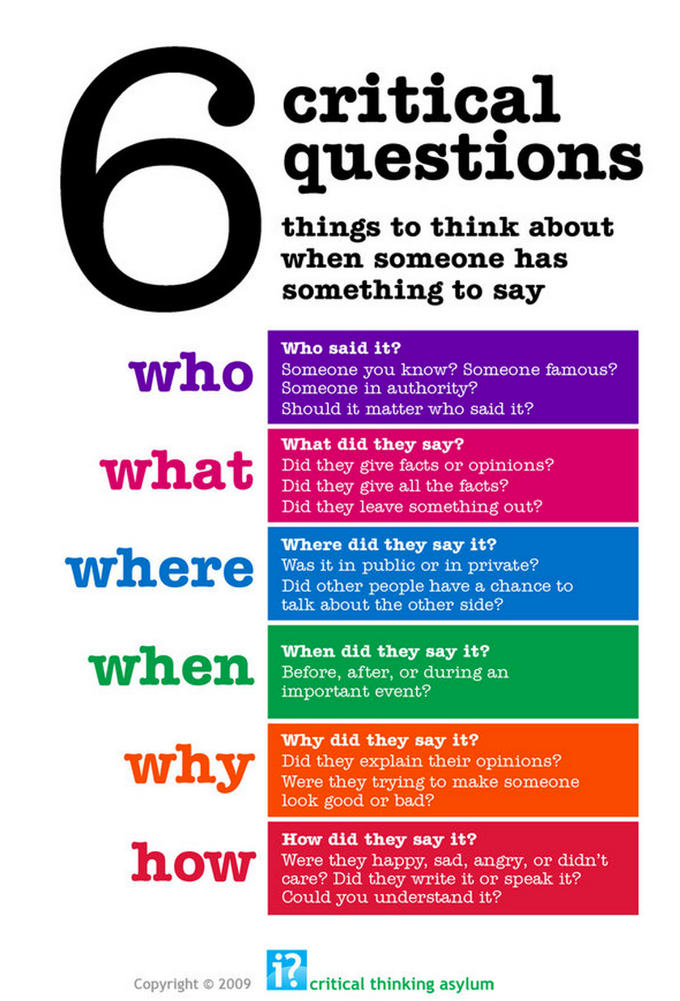
Ways of Critical Thinking

Slide 8
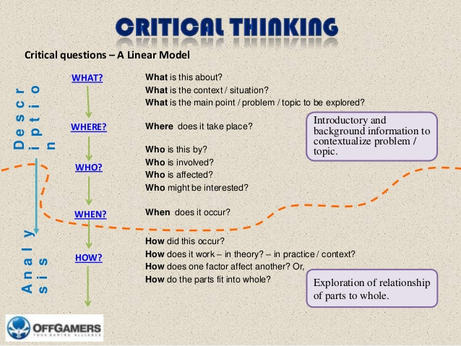
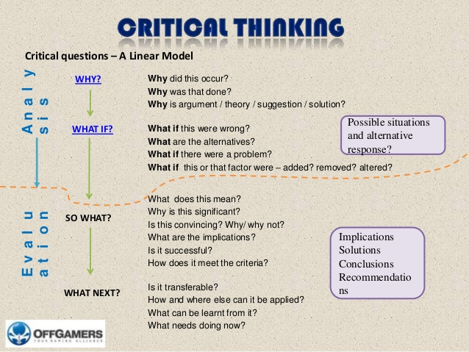
Model: Critical Thinking

Slide 9
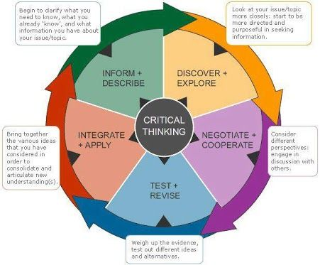
Steps in Critical Thinking

Slide 10
Steps in Critical Thinking: Formulating your argument
Focus on a question
Identify and formulate the question
Develop criteria for judging possible answers
Develop a plan for collecting data
Develop an argument
Generate premises and conclusions (the “whereas” and “therefore”)
Develop reasoning steps/support for conclusions (the “why”)

Slide 11
Steps in Critical Thinking: Deconstructing your Argument
Analyze arguments
Identify conclusions
Identify unstated reasons (assumptions)
Identify stated reasons
Identify and handle irrelevance
See the structure of an argument
Summarize

Slide 12
Steps in Critical Thinking: Clarifying Arguments
Ask and answer questions of clarification and/or challenge, such as:
Why?
What is your main point?
What do you mean by…?
What would be an example?
What would be an exception?
How does that apply to this case (describe a case, which might well appear to be a counter example)?
What difference does it make?
What are the facts?
Is this what you are saying: ____________?
Would you say some more about that?

Slide 13
Steps in Critical Thinking: Knowing/Analyzing Sources
Judge the credibility of a source. Major criteria (but not necessary conditions):
Expertise
Lack of conflict of interest
Agreement among sources
Reputation or risk to reputation
Use of established procedures
Ability to give reasons

Slide 14
Steps in Critical Thinking: Knowing the Basis for Decisions
Example: guilt or innocence of an accused criminal defendant
Is the evidence physical or circumstantial? How good is the evidence? Were there eyewitnesses? How reliable are they?
Direct observations are strong evidence because:
Minimal inference involved
Short time interval between observation and report
Report by the observer, rather than someone else (that is, the report is not hearsay, and can be verified)
Corroboration or possibility of corroboration
Good access to actual physical evidence
Competent employment of technology, if technology is useful
Satisfaction by observer (and reporter, if a different person) of credibility criteria

Slide 15
Think for Yourself: Beginning to Think About Your Thinking
To begin to think about your thinking, make a list of any problems you believe currently exist with your thinking.
Try to be as explicit as possible.
The more problems you identify the better.
For each problem you identify, complete the following statements:
One problem with my thinking is…
This is a problem because…
If I adequately addressed this problem, the quality of my life would improve in the following ways…

Slide 16
Think for Yourself: Critique Your Thinking
Consider your thinking in these domains of your life: at work, in personal relationships, in teaching, in intimate relationships, as a reader, as a writer, in planning your life, in dealing with your emotions, in figuring out complex situations. Complete these statements:
Right now, I believe my thinking across all domains of my life is of ______________ quality. I based this judgment on _________________.
In the following areas, I think very well…
In the following areas, my thinking is OK, not great, but not terrible either…
In the following areas, my thinking is probably of low quality…
List at least three areas for each of the above.

Slide 17
In Summary: Critical Thinking
Using 5W1H
Description, Analysis, Interpretation, Evaluate, Mind Mapping, etc.
Critical thinking is aimed at achieving the best possible outcomes
Gathering and evaluating information from as many different sources possible.
Critical thinking requires a clear, often uncomfortable, assessment of your personal strengths, weaknesses and preferences and their possible impact on decisions you may make.
Critical thinking requires the development and use of foresight as far as this is possible. As Doris Day sang, “the future’s not ours to see”.
Implementing the decisions made arising from critical thinking must take into account an assessment of possible outcomes and ways of avoiding potentially negative outcomes, or at least lessening their impact.
Critical thinking involves reviewing the results of the application of decisions made and implementing change where possible.

Slide 18
Creativity and Innovation
Critical Thinking leads to Creativity and Innovation
Creativity and innovation are two related but separate notions, and each is required for workplace success.
Creativity doesn't always run company inventions and growth; innovation does. However, innovation doesn't happen without creative people on board.
Generating creativity means allowing people to think outside the box and go against the norm sometimes.

Slide 19
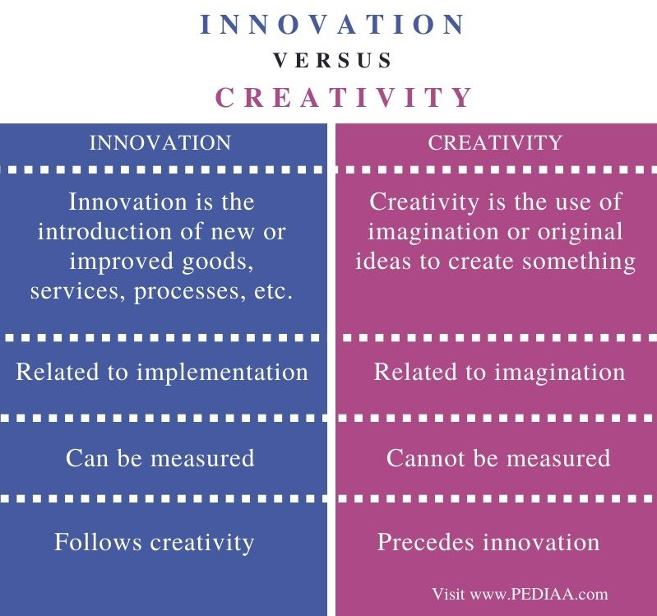

Slide 20
What is Creativity?
Creativity is the act of turning new and imaginative ideas into reality.
Creativity is characterized by the ability to perceive the world in new ways, to find hidden patterns, to make connections between seemingly unrelated phenomena, and to generate solutions.
Creativity involves two processes: thinking, then producing.
Creativity is the process of bringing something new into being. It requires passion and commitment.

Slide 21
Importance of Creativity
Creativity can help a company manage tasks, improve staff performance and create quality products.
It is also vital in fostering a likeable and aspirational company image.
With consumers now able to get a snapshot of what company life is like, businesses need to be able to depict their inner culture in a way that makes it seem appealing.
As new technologies continue to develop and become available, companies have to be flexible and able to keep up to date.
Creativity allows them to easily identify new ways in which technology can be applied to help their businesses.
Allowing employees to be more creative can inspire them to come up with more interesting ideas as well as improve their overall output.

Slide 22
Creativity Process
Preparation
successful creations are preceded by investigation and information gathering. It can be achieved by gathering information from journals, attending meeting seminars etc.
Incubation
creative person allows their sub consciousness mind to dwell over tremendous amount of ideas and information accumulated during the preparation phase.
Insight
the moment when the person is able to locate solution to their problems. Generally in most of the cases ideas come to person in incremental way. The person improves on solution slowly and steadily.
Evaluation
this phase is regarded as the most emotional trying part, when one feels uncertain and insecure and thinks about reaction of other people.
Elaboration
this is the most difficult step of creativity endeavour and requires great self discipline, dedication and perseverance.

Slide 23
Innovation
The word “innovation” is derived from the Latin verb “Innovare”, which means to renew.
It means to improve or to replace something, for example, a process, a product, or a service.
Innovation is a process by which a domain, a product, or a service is renewed and brought up to date by applying new processes, introducing new techniques, or establishing successful ideas to create new value.

Slide 24
Types of Innovation
Process improvement and organizational innovation: The improvement of processes through continuous improvement and the development of new solutions.
Product development: The development of innovative products or product features.
Service innovation: The creation and introduction of new services for customers and partners.
Business Model Innovation: The development of innovative business models and new revenue streams.

Slide 25
Importance of Innovation
Innovation is important because it’s the only way that you can differentiate your products and services from those of your competitors.
For customers and clients to choose your business, your offer needs to be distinctive and valuable, and the only way to achieve this is through innovation.
Competitive Edge
Identification of Customer needs
Innovation in process or product or services
New advertising system
Offering the fastest delivery to customers
Attracting more customers
Business growth

